Slide 1

Diabetic Retinopathy Detection Using Machine Learning and Deep Learning
The Unit for Data Science and Analytics at the Hayden Library presents:
Revolutionizing Medical Imaging for Early Detection
Presented By : Umang Bid

Slide 2
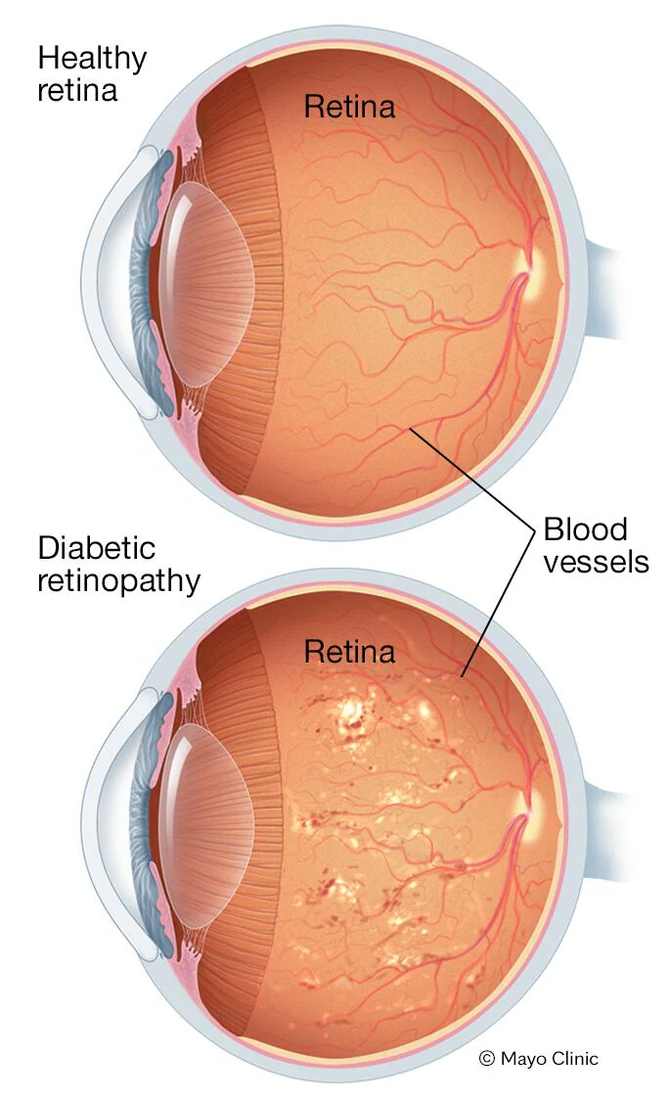
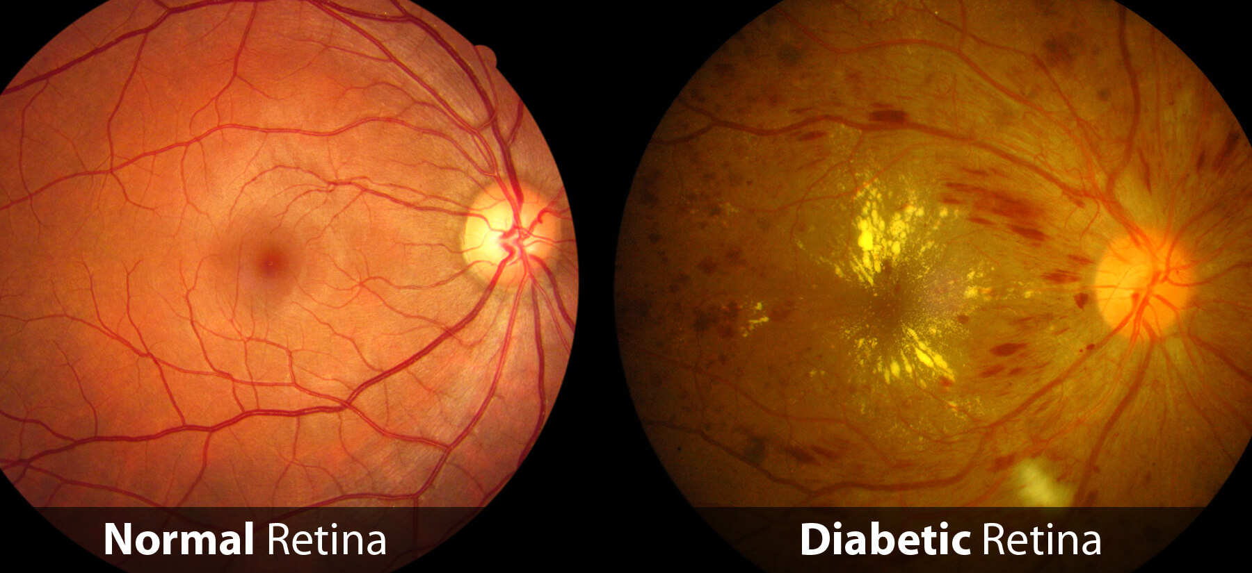
Diabetic retinopathy is a diabetes-related complication that affects the eyes. It occurs when high blood sugar levels cause damage to the blood vessels in the retina, the light-sensitive tissue at the back of the eye.
What Diabetic Retinopathy Does:
Blood Vessel Damage: Weakens retinal blood vessels, causing:
Microaneurysms: Bulges that may leak fluid or blood.
Hemorrhages: Spots of bleeding.
Exudates: Deposits of fat or protein.
New Fragile Blood Vessels: Abnormal vessels form, leading to:
Retinal Detachment: Retina pulling away from its tissue.
Scar Tissue: Causes vision distortion or loss.
Vision Problems:
Blurry Vision: From fluid leakage.
Dark Spots (Floaters): Caused by bleeding.
Vision Loss: Can become permanent if untreated.

Slide 3
Problem Statement:
Diabetic retinopathy (DR) is a leading cause of vision impairment, affecting millions globally.
It develops from damaged retinal blood vessels due to prolonged high blood sugar levels.
The disease often progresses silently, emphasizing the importance of early detection to prevent blindness.
Goal:
Leverage Machine Learning (ML) and Deep Learning (DL) to:
Accurately detect and classify diabetic retinopathy stages from retinal images.
Enable faster and more reliable diagnoses compared to traditional methods.
Support ophthalmologists in making informed treatment decisions.
Relevance:
Addresses gaps in manual screening processes (time-intensive, subject to human error).
Aligns with global healthcare objectives for early intervention and accessibility.
Current methods for detecting diabetic retinopathy rely on dilated eye exams and manual inspection of retinal images, which can be subjective, time-consuming, and prone to human error. The challenges are compounded by the vast number of patients requiring screening, overwhelming healthcare systems and limiting timely access to care. In addition, early-stage DR often goes undetected as it may not present with obvious symptoms, making it difficult to diagnose without specialized training.

Slide 4
Dataset Characteristics
Size: 1151 rows × 19 columns
Data Types:
Binary: 3 columns (quality, pre_screening, am_fm_classification)
Integer: 6 columns (ma1 to ma6)
Continuous: 9 columns (exudate1 to exudate8, macula_opticdisc_distance, opticdisc_diameter)
Target: 1 column (label).
Missing Values: None (all columns are complete).
Exploratory Insights
Target Distribution: The binary label column helps categorize cases into two groups: with or without symptoms of diabetic retinopathy.
Key Features:
Microaneurysms (ma1 to ma6): Serve as crucial early indicators for diagnosing diabetic retinopathy.
Exudates (exudate1 to exudate8): Provide insights into advanced stages of the condition.
Distance Measurements: Quantify structural relationships within the retina that influence diagnosis.
This dataset is rich with features relevant to medical imaging and diagnostics, offering significant potential for building predictive models.

Slide 5
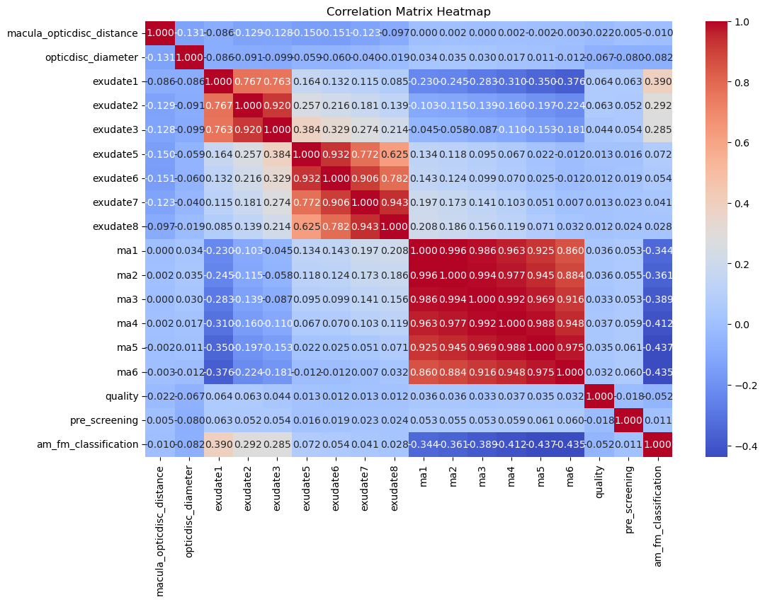
Correlation Matrix Insights:
High Correlation: Strong relationships among exudate features (exudate1 to exudate8), indicating they provide similar information regarding exudates in diabetic retinopathy.
Exudates and Microaneurysms: Moderate positive correlation between microaneurysm features (ma1 to ma6) and exudates, suggesting that higher microaneurysm counts are associated with the presence of exudates.
Optic Disc and Macula: Weak negative correlation between macula_opticdisc_distance and exudates, and between opticdisc_diameter and exudates, implying limited impact of these variables on exudate formation.
Quality and Screening: quality and pre_screening features show weak correlations with other variables, suggesting they have a minimal influence on the key features for detecting diabetic retinopathy.
Data Visualization

Slide 6
Traditional Machine Learning Models Implementation
Random Forest | Random Forest is an ensemble learning method that uses multiple decision trees to make predictions.
Logistic Regression | Logistic Regression is a simple and interpretable linear model used for binary classification.
Support Vector Machine (SVM) | SVM is a powerful classifier that finds the hyperplane that best separates different classes in a high-dimensional space.
K-Nearest Neighbors (KNN) | KNN is a non-parametric algorithm that classifies a sample based on the majority vote of its neighbors.
Gradient Boosting | Gradient Boosting is an ensemble technique that builds trees sequentially, each one correcting the errors of the previous one
XGBoost | XGBoost is a highly efficient and scalable implementation of gradient boosting.
Neural Network (MLP) | A Multi-Layer Perceptron (MLP) is a type of neural network that consists of multiple layers of neurons, where each neuron is connected to every other neuron in adjacent layers.
Decision Tree | A Decision Tree is a model that splits data into subsets based on feature values, creating a tree-like structure.

Slide 7
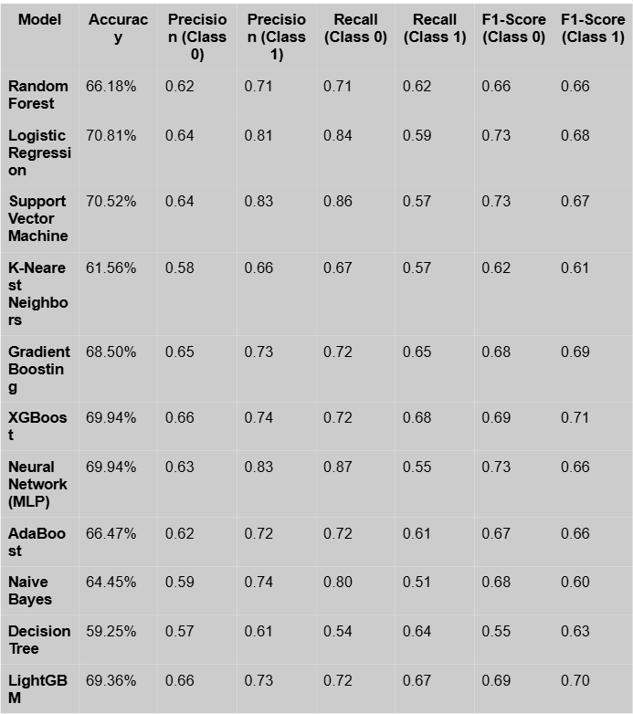
Results:
Best Performing Models: Logistic Regression, SVM, and XGBoost consistently demonstrated the highest accuracy and relatively balanced performance between precision and recall.
Challenges: Several models, such as Decision Tree and KNN, showed weaker overall performance, especially in balancing precision and recall.
Key Insights: Models such as Neural Network (MLP) and XGBoost exhibited good precision for Class 1 but struggled with recall for Class 1, highlighting challenges in handling imbalanced classes. LightGBM and Gradient Boosting offered solid alternatives, providing a good balance between the two classes.

Slide 8
Regularization Techniques in Logistic Regression
Regularization is a technique used in machine learning to prevent overfitting by adding a penalty to the model’s complexity. It discourages the model from becoming overly complex, which can lead to poor generalization on new, unseen data.
Model Optimization & Cross-Validation
Best Model: Regularized Logistic Regression with L2 penalty, C = 10, and l1_ratio = 0.1 Accuracy: 73.9%
Optimized using GridSearchCV, leading to improved performance over basic models.
Dimensionality Reduction with PCA
PCA + Logistic Regression Accuracy: 66%
Outcome: PCA reduced the feature space, though slightly decreased the model’s performance in comparison to the full set.
L1 Regularization (Lasso):
Accuracy: 73.7%
Precision & Recall: Balanced between classes, with a slightly higher precision for class 1 (0.83) and recall for class 0 (0.85).
Outcome: Suitable when we need feature selection, as L1 tends to zero out irrelevant features.
L2 Regularization (Ridge):
Accuracy: 70.8%
Precision & Recall: Precision is higher for class 1 (0.81) while recall is stronger for class 0 (0.84).
Outcome: Works well when we want to prevent overfitting but without eliminating features.
Elastic Net Regularization:
Accuracy: 68.2%
Precision & Recall: A compromise between L1 and L2, with a balanced trade-off between classes.
Outcome: Useful when a combination of both L1 and L2 regularization is needed.

Slide 9
Deep Learning For Diabetic Retinopathy Detection
APTOS 2019 Blindness Detection Dataset Overview

Slide 10
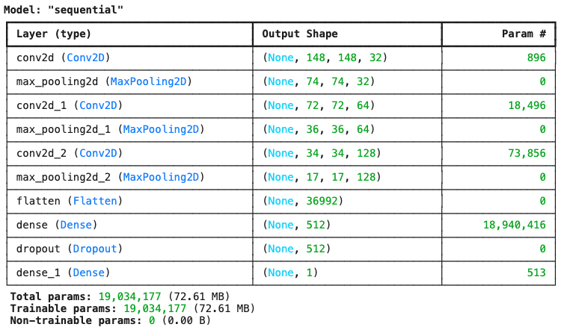

Slide 11
Vision Transformer (ViT)
Vision Transformer (ViT) is a model for image classification that uses the transformer architecture, which is also popular in language tasks.
Why We Used ViT:
Great at Learning from Images: ViT works well on image tasks because it captures relationships between different parts of the image, which is important for tasks like classifying diseases in retinal scans.
Pre-trained on Large Datasets: ViT has been trained on large image datasets, so it already understands basic image features, helping it perform better even with smaller datasets like ours.
How Does Vision Transformer (ViT) Work?
ViT divides an image into smaller patches (like breaking an image into pieces), then processes these patches to learn patterns across the entire image. It uses a process called self-attention to focus on important parts of the image, just like humans focus on key areas when analyzing something visually.
Results of the Model Training:
Training Accuracy: 96.27% — The model performed well on the training data.
Validation Accuracy: 69.92% — The model did well on the training data, but struggled to generalize to new data, possibly due to overfitting.

Slide 12
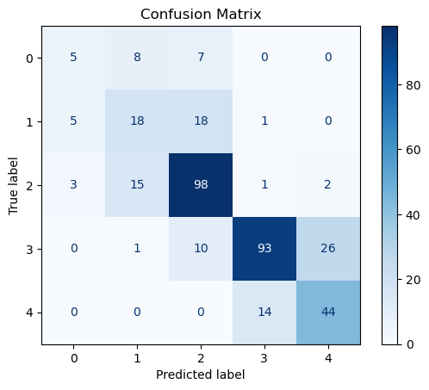
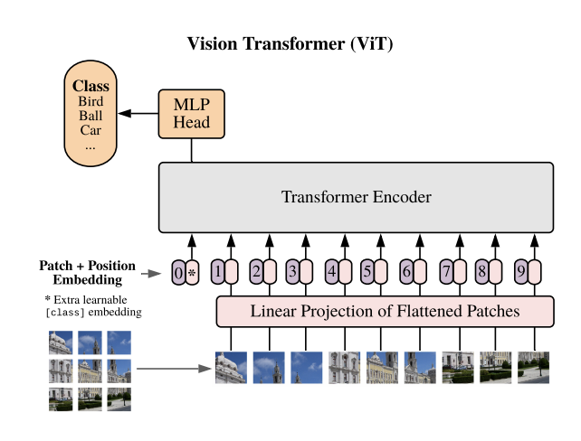
Confusion Matrix
The confusion matrix helps us understand how well the Vision Transformer (ViT) model is classifying retinal disease images into the correct categories.
True Positives (TP): These are the images where the model correctly identifies the presence of a disease (e.g., predicting a disease when it's truly present).
False Positives (FP): These are cases where the model incorrectly predicts the presence of a disease when the image does not actually show any disease (e.g., predicting a disease when it’s healthy).
True Negatives (TN): These are images where the model correctly predicts the absence of a disease (e.g., correctly identifying a healthy retina).
False Negatives (FN): These are cases where the model misses the disease, incorrectly predicting a healthy retina when the image actually shows a disease.

